Slide 1
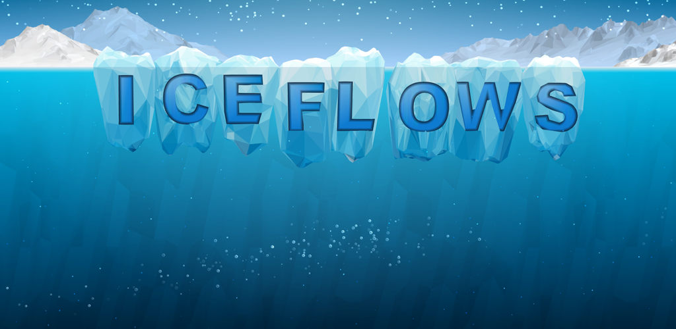

Lesson 2:
Playing the Game

Slide 2

Game website http://www.iceflowsgame.com
Ice Flows Game Teacher Resource

Slide 3
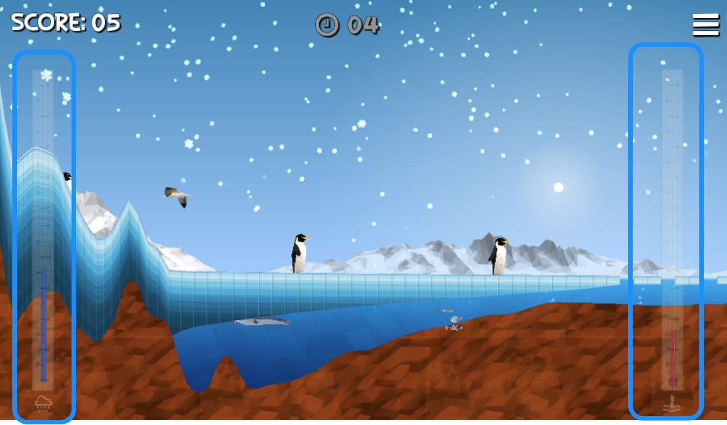
How to play the game…

Slide 4
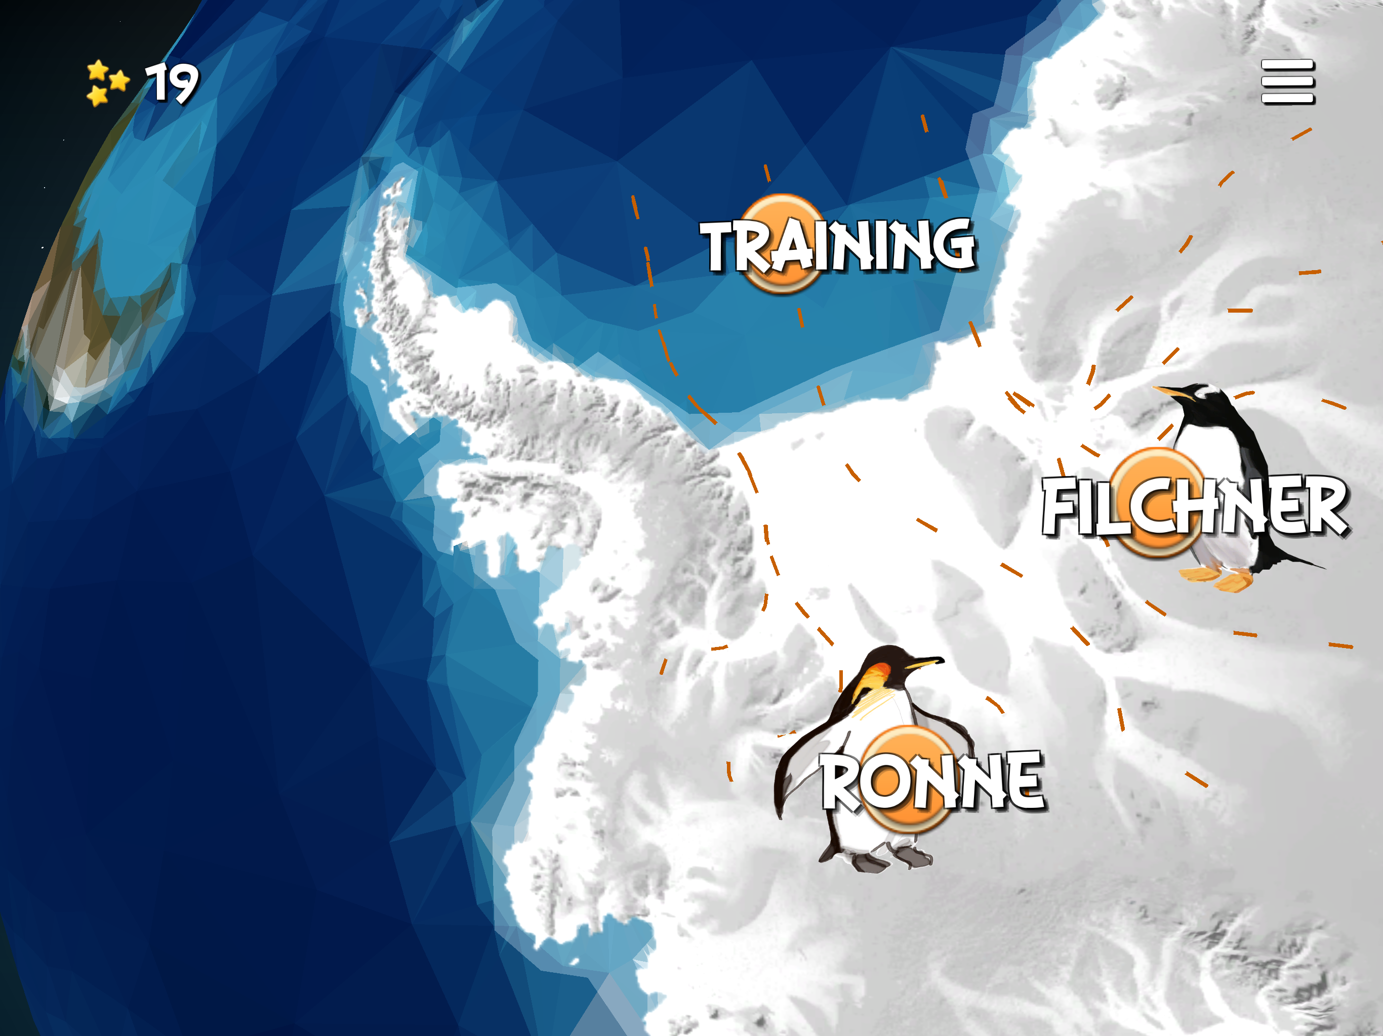

Slide 5
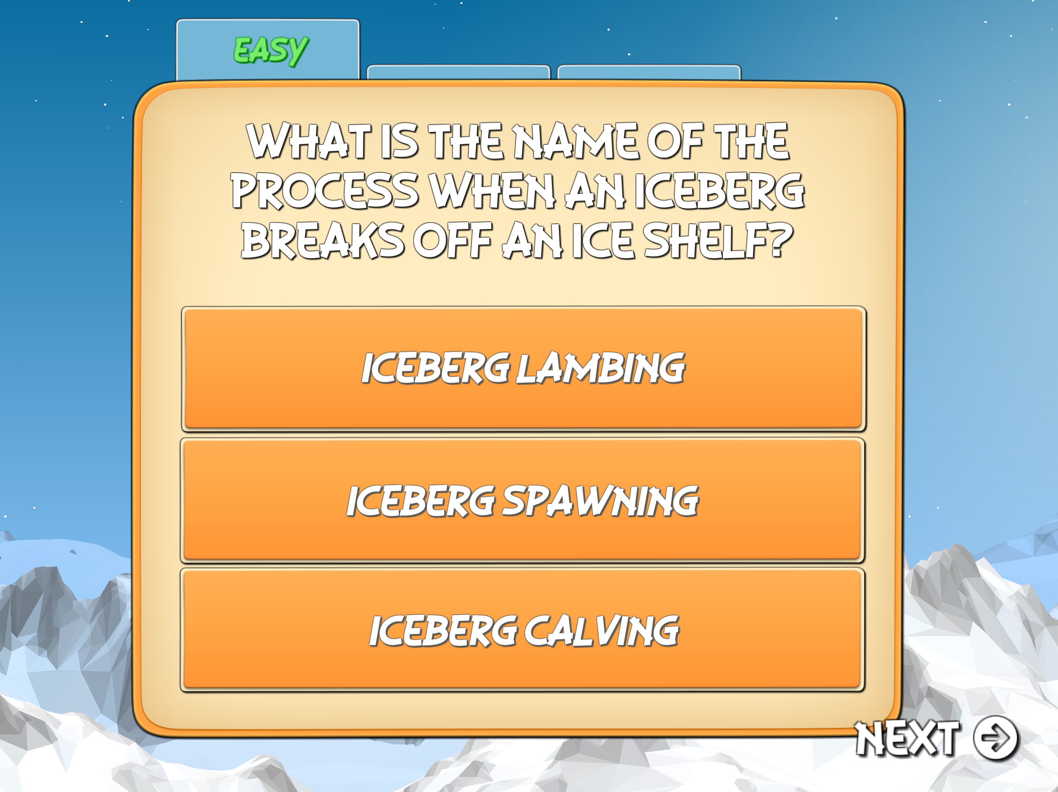
Quiz

Slide 6
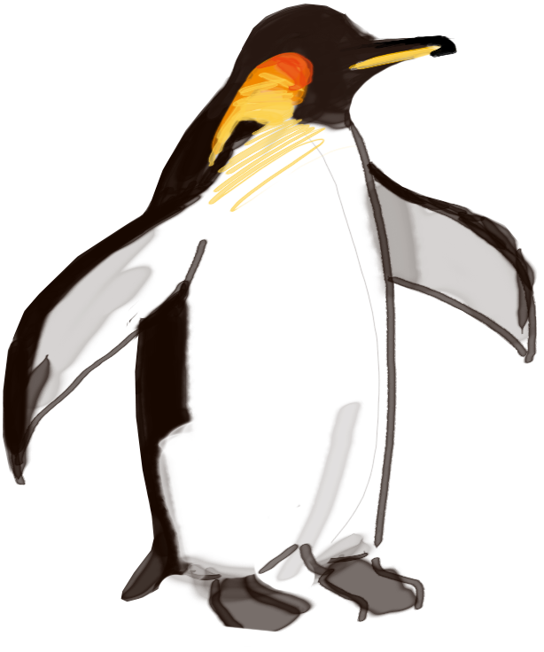
Use the Ice Sheet Model experiment sheet

Slide 7
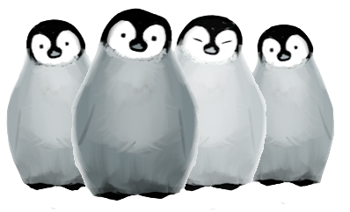
What changes would you make to the game?

Slide 8

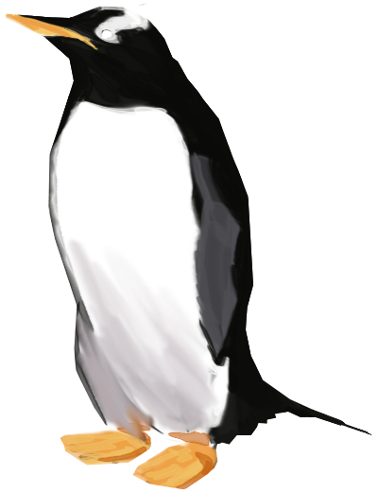
Thanks for playing!

